Slide 1

Instrument Data Processing
MMR April 2020
AMMOS Technology
Jack Lightholder

Slide 2
Instrument Data Processing (CODEX)
Schedule
ID | WBS | CAM | Task Name | % Complete | Duration | Planned Start | Actual Start | Finished
375 | 05.01.13 | JLightholder | CODEX - Complex Data Explorer | 75% | 224 d | Tue 10/1/19 | Tue 10/1/19 | Fri 9/25/20
376 | 05.01.13 | JLightholder | Design and Implement "Data Quality Scan" User Interface | 100% | 62 d | Tue 10/1/19 | Tue 10/1/19 | 12/31/19
377 | 05.01.13 | JLightholder | Feature Bar Extension to Support Multiple Interaction Windows | 100% | 40 d | Thu 1/2/20 | 1/2/20 | 2/28/20
378 | 05.01.13 | JLightholder | Extend Server Data Reader Capabilities to for Additional Data Types | 100% | 33 d | Mon 3/2/20 | 3/1/20 | 4/15/20
379 | 05.01.13 | JLightholder | Extend Runtime Prediction Model to Support Features/Samples in Calculation | 100% | 22 d | Thu 4/16/20 | 3/1/20 | 3/15/20
380 | 05.01.13 | JLightholder | Design and Implement "Model Training" User Interface | 100% | 20 d | 3/15/20 | NA | 4/1/20
381 | 05.01.13 | JLightholder | Enable Session Saving / Loading | 0% | 33 d | Tue 6/16/20 | NA
382 | 05.01.13 | JLightholder | Enable Data / Code / Selection / Feature Export | 0% | 17 d | Mon 8/3/20 | NA
383 | 05.01.13 | JLightholder | Advanced User Guidance Through Dynamic Error Reporting | 0% | 22 d | Wed 8/26/20 | NA

Slide 3
CODEX
Feature Correlation Designed & Implemented
Sort features alphabetically, or by correlation.
Used to reduce noise in feature importance due to correlation (split importance).
Visual guidance to users as to which features relate to one another.
Select and save feature groups for follow on analysis.

Slide 4
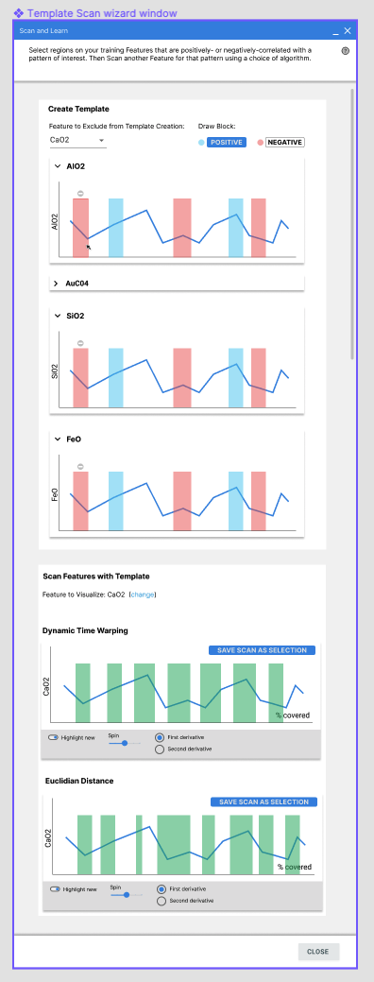
CODEX
”Find More Like This” Designed & Implemented
Users specify regions of interest and regions of explicit lack of interest
Positive & negative labels
Visualizes on other features, since this is a multi-dimensional problem
Trains and detects regions of interest on a hold-out feature
Introduces concept of position and negative label tracking

Slide 5
CODEX
Infusion Status
MAIA Mission Integration Conversations
Initial meeting with science data systems and instrument data systems team leads.
Provided access to CODEX for the team to explore
Planning another demonstration of the tool for the larger team
Planning demonstration day with section 398 science data system and instrument data system groups to get user feedback.
Workshop where users bring their own data to use in CODEX
Design feedback for team on how users use the tool and features they desire.
Presented at GSAW 2020
Multiple people interested in utilizing CODEX outside of JPL.
Open sourced to leverage this growing user community.

Slide 6
CODEX
Plans for Next Month
Performance improvements on larger data sets
Implement session saving/loading for multiple users and work states
User testing and future usability improvement documentation
Testing with MSL data

Slide 7
CODEX
Financial Status
Complex Data Explorer
Actual YTD costs are $131K versus plan of $93K
Taking advantage of excess availability in workforce to get ahead.
Now available and burning hot to adjust (ahead of schedule!)
Could slow down to accommodate schedule
Could support additional funding with additional deliverables if available

